Slide 1


Mantid
Manipulation and Analysis Toolkit for ISIS data

Slide 2
Agenda
Time | Item
2:00 | Introduction
2:15 | Python Overview and Running Algorithms
2:30 | Exercise 1: Removing the Prompt pulse
3:00 | Generating and generalising scripts
3:10 | Exercise 2: Create a reusable script
3:40 | Manipulating graphs and matrices
3:50 | Exercise 3: Controlling MantidPlot
4:20 | Mantid on the Command line
4:30 | Exercise 4: Mask detectors by detector efficiency
5:00 | Finish

Slide 3
Project Aims
Aims
  To provide a framework for Data Analysis that is not instrument or technique/dependent.
  Support multiple target platforms (Windows, Linux).
    Mac in the future too.
  Easily extensible by Instruments Scientists/Users.
    Python scripts
    New plugin algorithms
  Freely redistributable to visiting scientists.
    GPL license

Slide 4
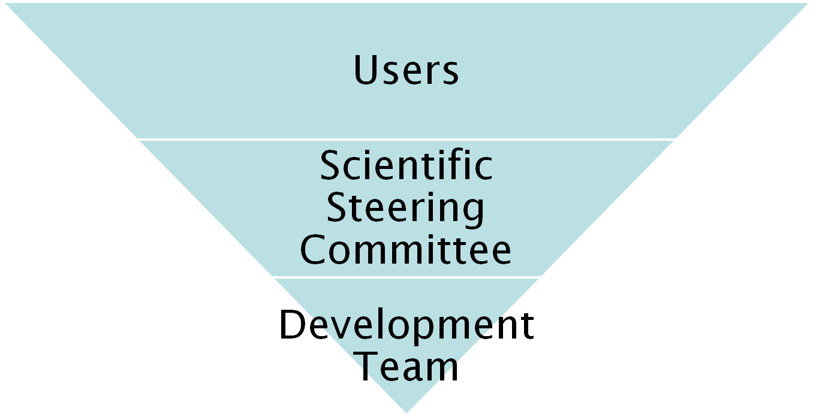
Project Organisation
27 beamlines, 1600 users
9 Key scientists representing every beamline.
PM &
6 Developers

Slide 5
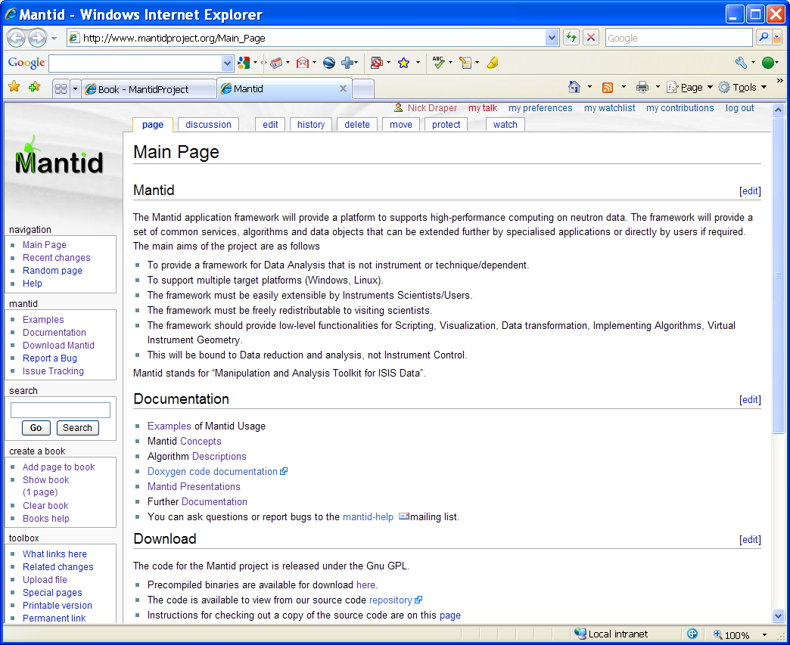
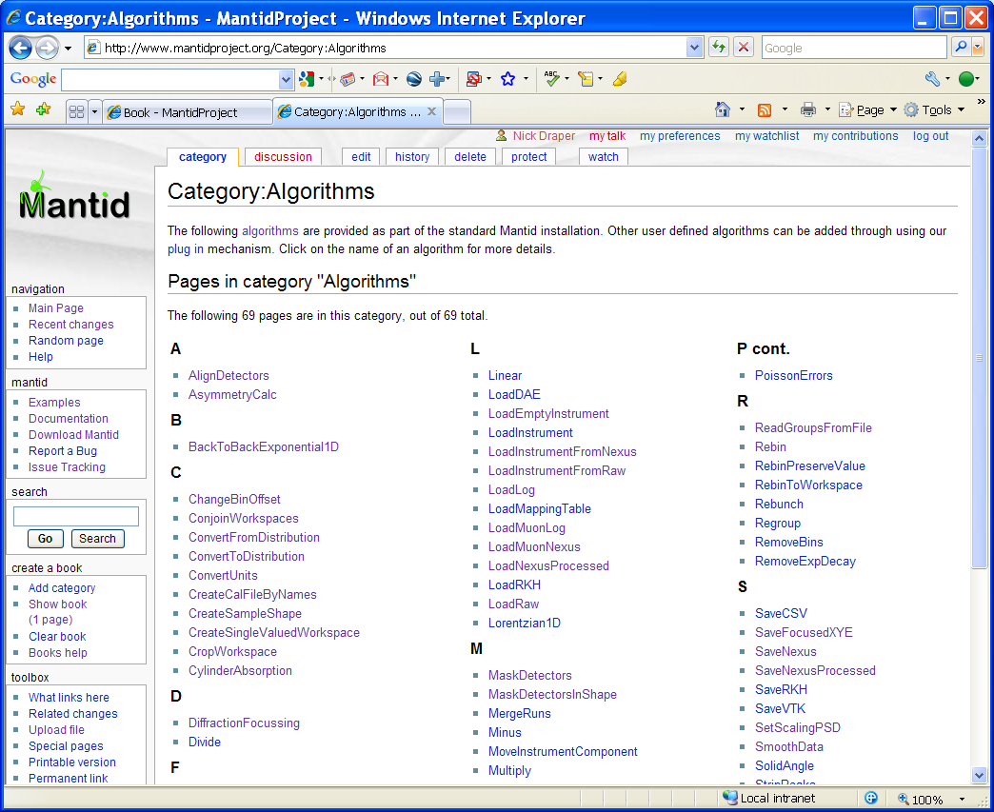
Project wiki
Help
  Documentation
    User
    Developer
  Examples
Download
www.mantidproject.org

Slide 6

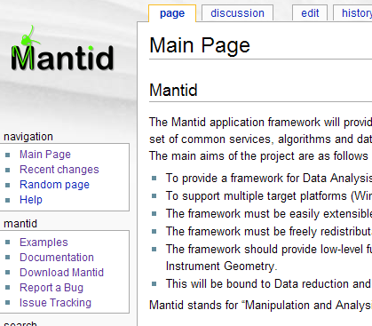
How to report a bug
Email mantid-help@mantidproject.org
Website
www.mantidproject.org
Phone (if urgent) 5228

Slide 7
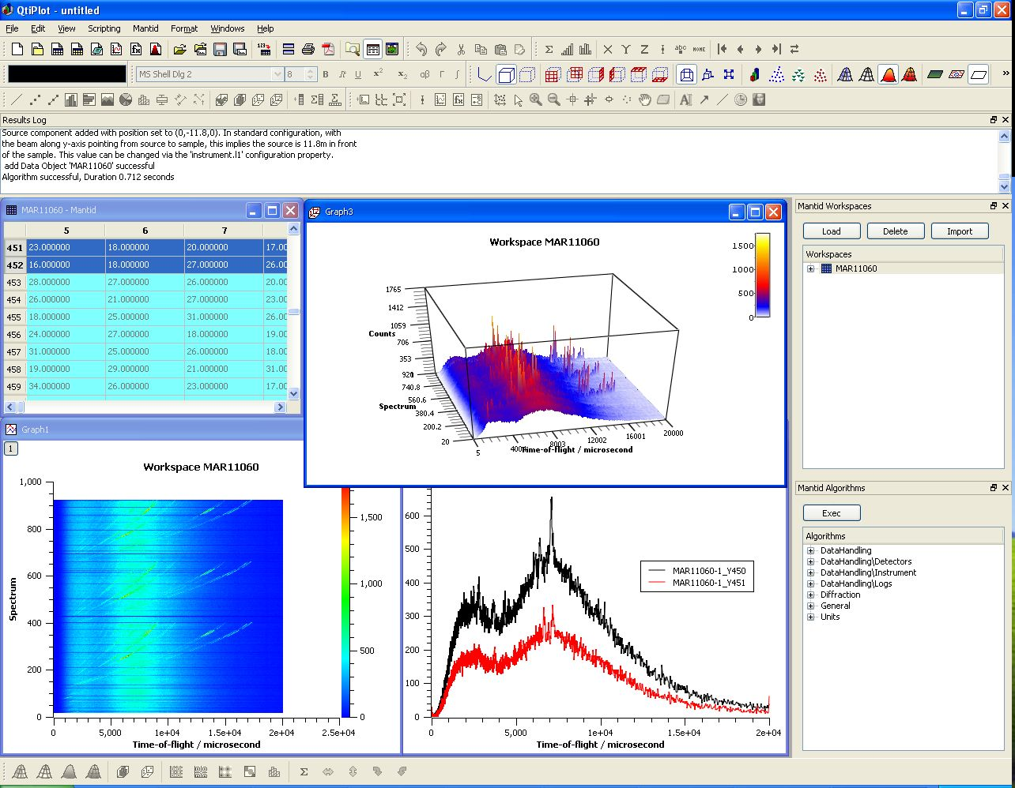
User Interfaces
Current Interfaces
  MantidPlot
    Plotting tool
    Data interaction and analysis.
    Instrument visualization
  Python
    Command line access and scripting
    Python scripting language
  Matlab Interface

Slide 8
Further Information
Project Web Page
  www.mantidproject.org
Project Introduction Document
  http://svn.mantidproject.org/mantid/trunk/Documents/Requirements/Project%20Introduction%20Document.doc
User Requirements Document
  http://svn.mantidproject.org/mantid/trunk/Documents/Requirements/URD.doc
Architectural Design Document
  http://svn.mantidproject.org/mantid/trunk/Documents/Design/Architecture%20Design%20Document.doc

Slide 9
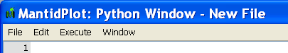
Preparation
Install Mantid
Grab a handout
Copy data files
  From USB:\Python Training\data
  Or \\olympic\babylon5\Public\Mantid Python Training\data
  To c:\MantidInstall\Data
Start MantidPlot
  Select menu Scripting\Script Window
  Shout if the new window title is not
Add Python to your Windows Path
  Start\My Computer -> right click -> properties
  Advanced tab -> Environment Variables
  Click Path in System variables then the edit button
  Go to the end of the line and add “;c:\python25”

